Slide 1

Topics of the presentation
TCP/IP
UDP
POP
HTTP/HTTPS

Slide 2

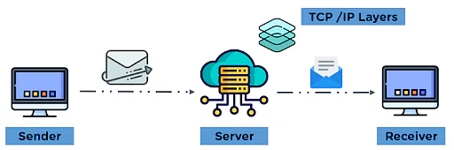
Introduction to the TCP/IP model
The TCP/IP model governs how data between two different devices is transmitted over the communication channel.

Slide 3
What is TCP/IP?
It stands for Transmission Control Protocol/Internet Protocol. TCP/IP is also known as an Internet Protocol.
It is a suite of communication protocols used to interconnect network devices on the internet.
It offers end to end packet delivery as it is connection-oriented.
It specifies how data is exchanged over the internet, and how it should be broken into packets.
It is designed to make the networks reliable with the ability to recover automatically from the failure of any device on the network.

Slide 4
How TCP/IP works?
TCP/IP uses the client-server model, in which a user or machine (a client) is provided a service, like sending a webpage, by another computer (a server) in the network.
Collectively, the TCP/IP suite of protocols is classified as 'stateless', which means each client's request is considered new because it is unrelated to previous requests. Being stateless frees up the network paths so they can be used continuously.

Slide 5
Why TCP/IP is important?
It is non - proprietary, therefore it can be modified easily.
It is compatible with all the operating systems, so it can communicate with any other system.
It is highly scalable, and as a routable protocol, it can determine the most efficient path through the network.
It is widely used in the current internet architecture.

Slide 6
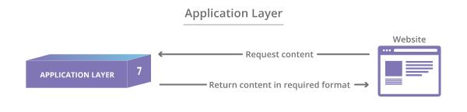
The 4 layers of the TCP/IP model
1. Application layer is the top-most layer of the TCP/IP model that provides the interfaces and protocols needed by the users.
It combines the functionalities of the session layer, the presentation layer and the application layer of the OSI model.
It performs node-to-node communication based on the user-interface.
It specifies the shared communications' protocols and interface methods used by the hosts in a communication network.
It is the layer closest to the end-user, implying that the application layer and the end-user can interact directly with the software application.

Slide 7
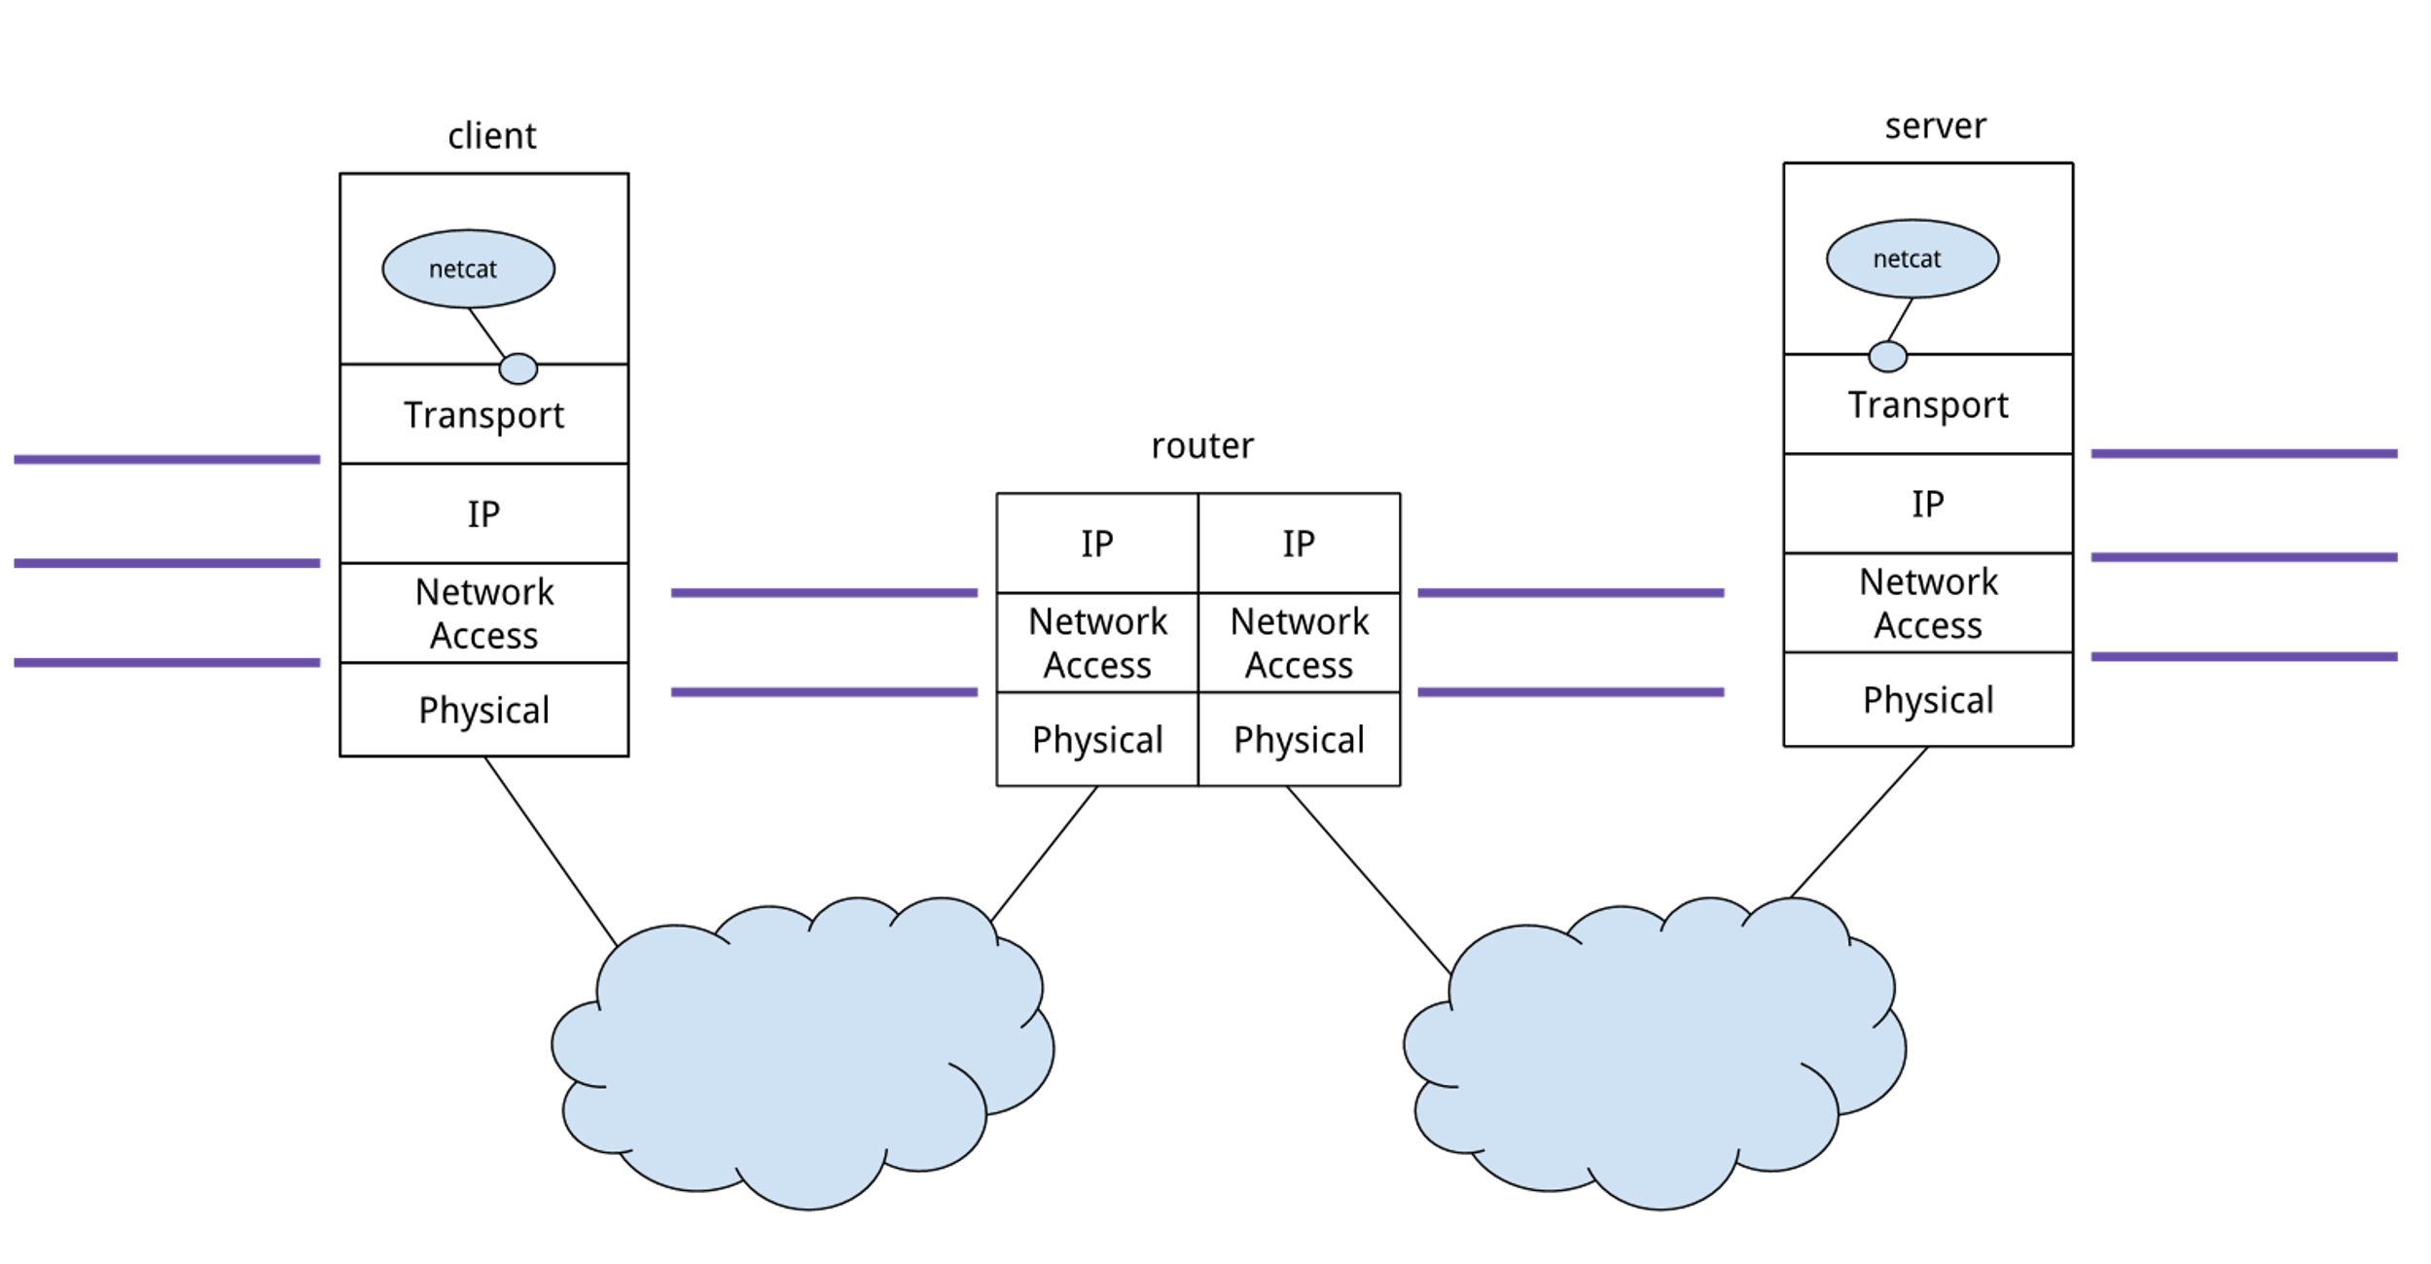
2. Transport layer is responsible for error-free, end-to-end delivery of data from the source host to the destination host.
It facilitates the communicating hosts to carry on a conversation.
It provides an interface for the users to the underlying network.
It can provide for a reliable connection. It can also carry out error checking, flow control, and verification.

Slide 8
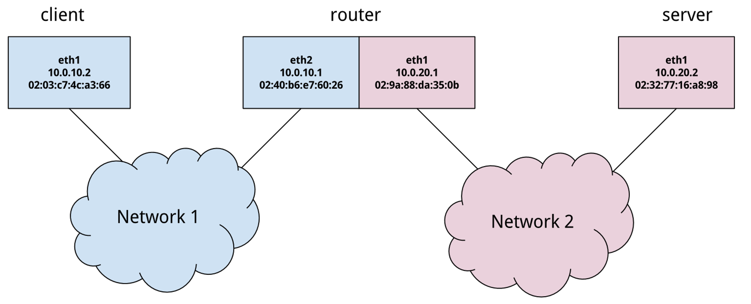
3. Internet layer is responsible for sending the data packets to their destination network.
The logical transmission of data takes place at this level.

Slide 9
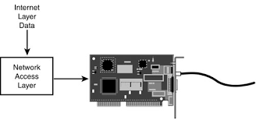
4. Network Access layer defines the procedure of data transmission over a network.
It is primarily in charge of the data transmission between two devices connected to a network.
This layer performs functions such as translating IP addresses to physical addresses and encapsulating IP datagrams into network frames.
In TCP/IP model, Network Access Layer is the lowermost layer.

Slide 10
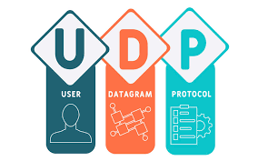
UDP
User Datagram Protocol (UDP) is a Transport Layer protocol. UDP is a part of the Internet Protocol suite, referred to as UDP/IP suite. Unlike TCP, it is an unreliable and connectionless protocol. So, there is no need to establish a connection prior to data transfer. The UDP helps to establish low-latency and loss-tolerating connections over the network. The UDP enables process to process communication.

Slide 11
Why do we need UDP?
For real-time services like computer gaming, voice or video communication, live conferences; we need UDP. Since high performance is needed, UDP permits packets to be dropped instead of processing delayed packets. There is no error checking in UDP, so it also saves bandwidth.
User Datagram Protocol (UDP) is more efficient in terms of both latency and bandwidth.

Slide 12

POP
Post Office Protocol (POP) is a type of computer networking and Internet standard protocol that extracts and retrieves email from a remote mail server for access by the host machine.
POP is an application layer protocol in the OSI model that provides end users the ability to fetch and receive email.

Slide 13
How does POP works?
Post Office Protocol (POP) is the primary protocol behind email communication. It works through a supporting email software client that integrates POP for connecting to the remote email server and downloading email messages to the recipient’s computer machine.
POP uses the TCP/IP protocol stack for network connection and works with Simple Mail Transfer Protocol (SMTP) for end-to-end email communication, where POP pulls messages and SMTP pushes them to the server.

Slide 14

HTTP
The Hypertext Transfer Protocol (HTTP) is a connectionless protocol.
HTTP client initiates a request and waits for a response from the server. When the server receives the request, the server processes the request and sends back the response to the HTTP client after which the client disconnects the connection.
The connection between client and server exists only during the current request and response time only.
HTTP is a stateless protocol as both the client and server know each other only during the current request.

Slide 15

HTTPS
Hypertext transfer protocol secure (HTTPS) is the secure version of HTTP, which is the primary protocol used to send data between a web browser and a website. HTTPS is encrypted in order to increase security of data transfer. This is particularly important when users transmit sensitive data, such as by logging into a bank account, email service, or health insurance provider.
Any website, especially those that require login credentials, should use HTTPS. In modern web browsers such as Chrome, websites that do not use HTTPS.

Slide 16
Why HTTPS is important?
HTTPS prevents websites from having their information broadcast in a way that’s easily viewed by anyone snooping on the network. When information is sent over regular HTTP, the information is broken into packets of data that can be easily robbed using free software. This makes communication over an unsecure medium, such as public Wi-Fi, highly vulnerable. In fact, all communications that occur over HTTP occur in a plain text, making them highly accessible to anyone with the correct tools, and vulnerable to on-path attacks.
With HTTPS, traffic is encrypted such that even if the packets are robbed, they will come across as nonsensical characters.

Slide 17
THANK YOU

